Slide 1

Test

Slide 2
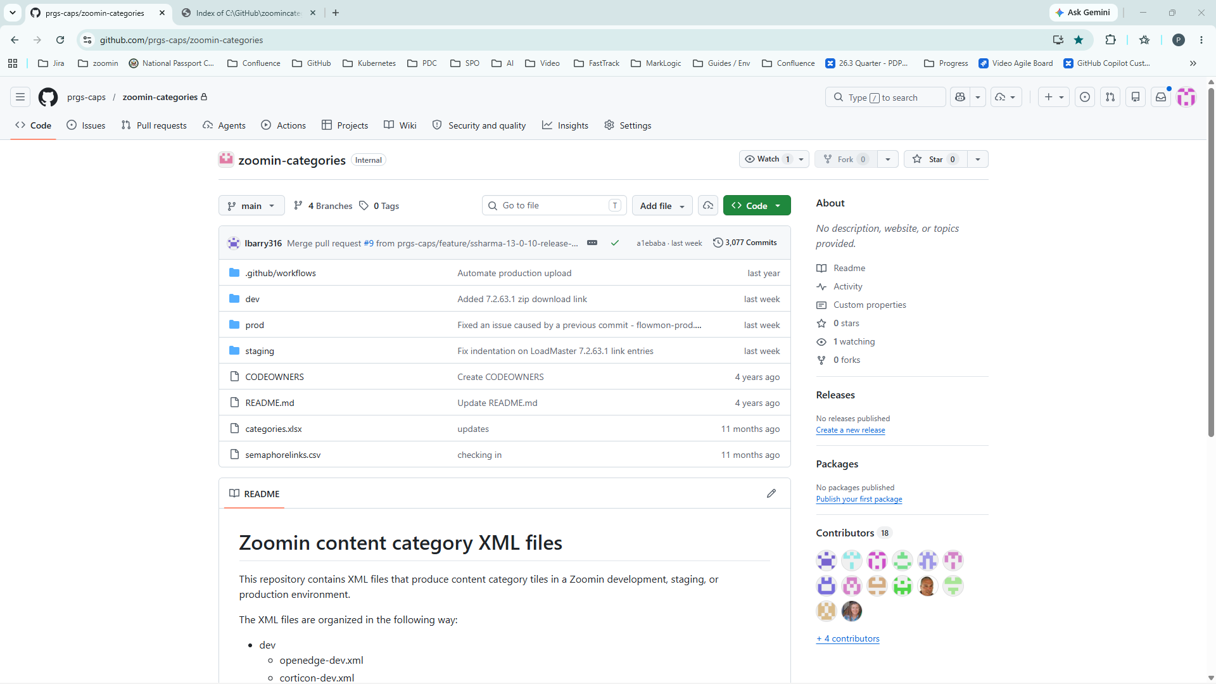
D:\GitHub\Video Production Apps\screenshot automater\screenshotautomation\screenshots\20260616_113437_0001.png
Narration for step 1
Notes:
Narration for step 1

Slide 3
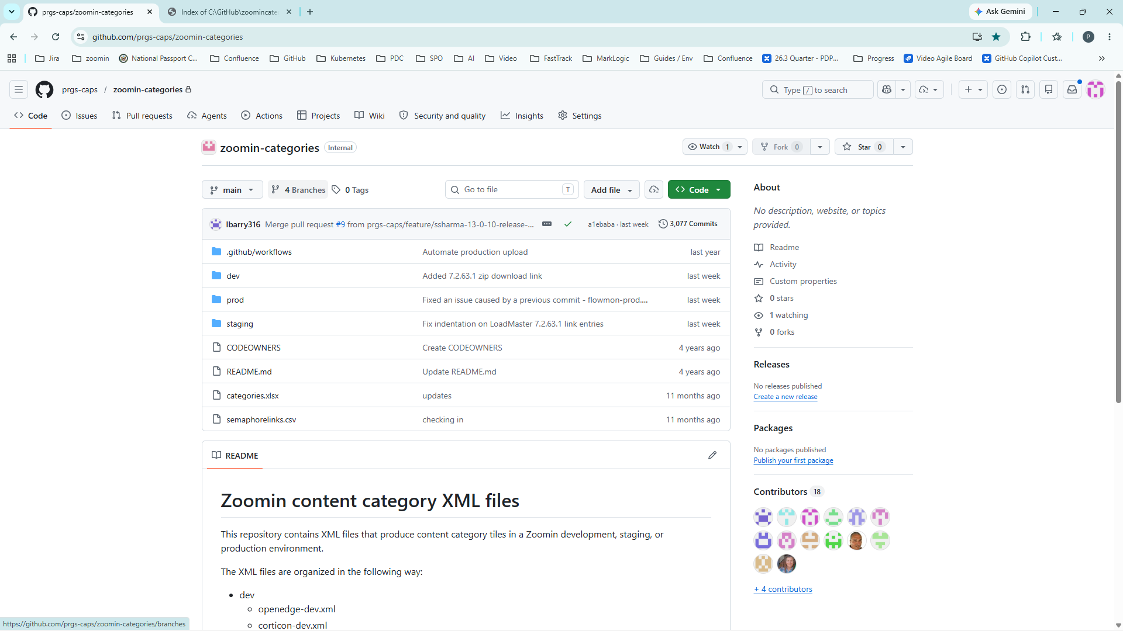
D:\GitHub\Video Production Apps\screenshot automater\screenshotautomation\screenshots\20260616_113443_0002.png
Narration for step 2
Notes:
Narration for step 2

Slide 4
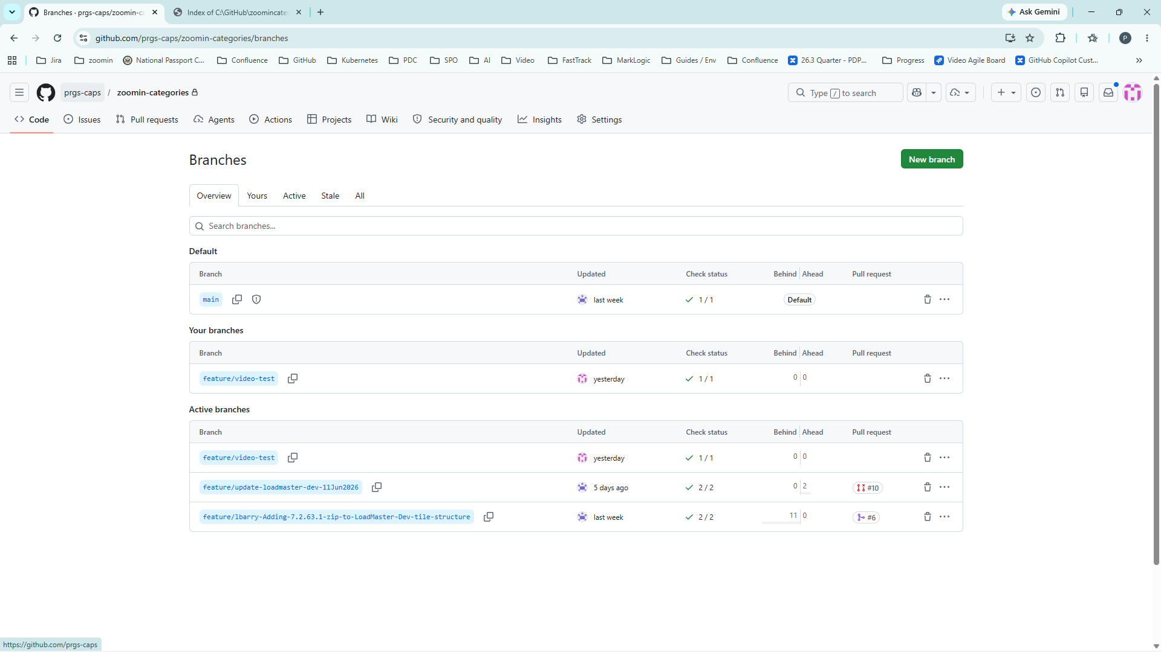
D:\GitHub\Video Production Apps\screenshot automater\screenshotautomation\screenshots\20260616_113448_0003.png
Narration for step 3
Notes:
Narration for step 3

Slide 5
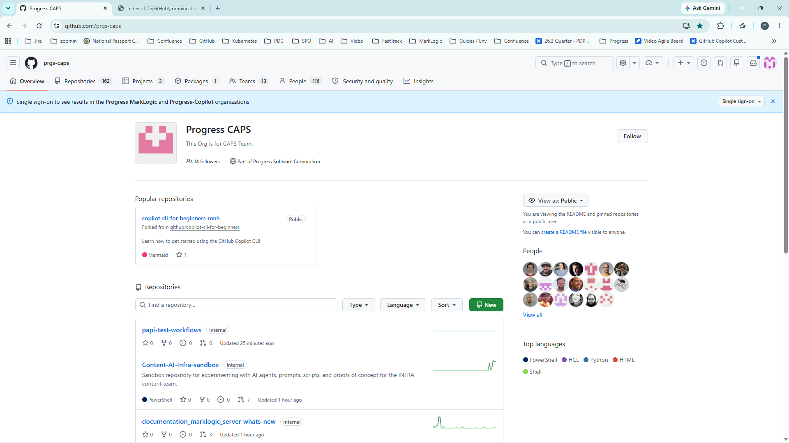
D:\GitHub\Video Production Apps\screenshot automater\screenshotautomation\screenshots\20260616_113452_0004.png
Narration for step 4
Notes:
Narration for step 4

